Slide 1
Python Course for Physicists (And everyone else!) Chunk 9: Matplotlib
By Jonathan Bollig
09.10.2025

Slide 2
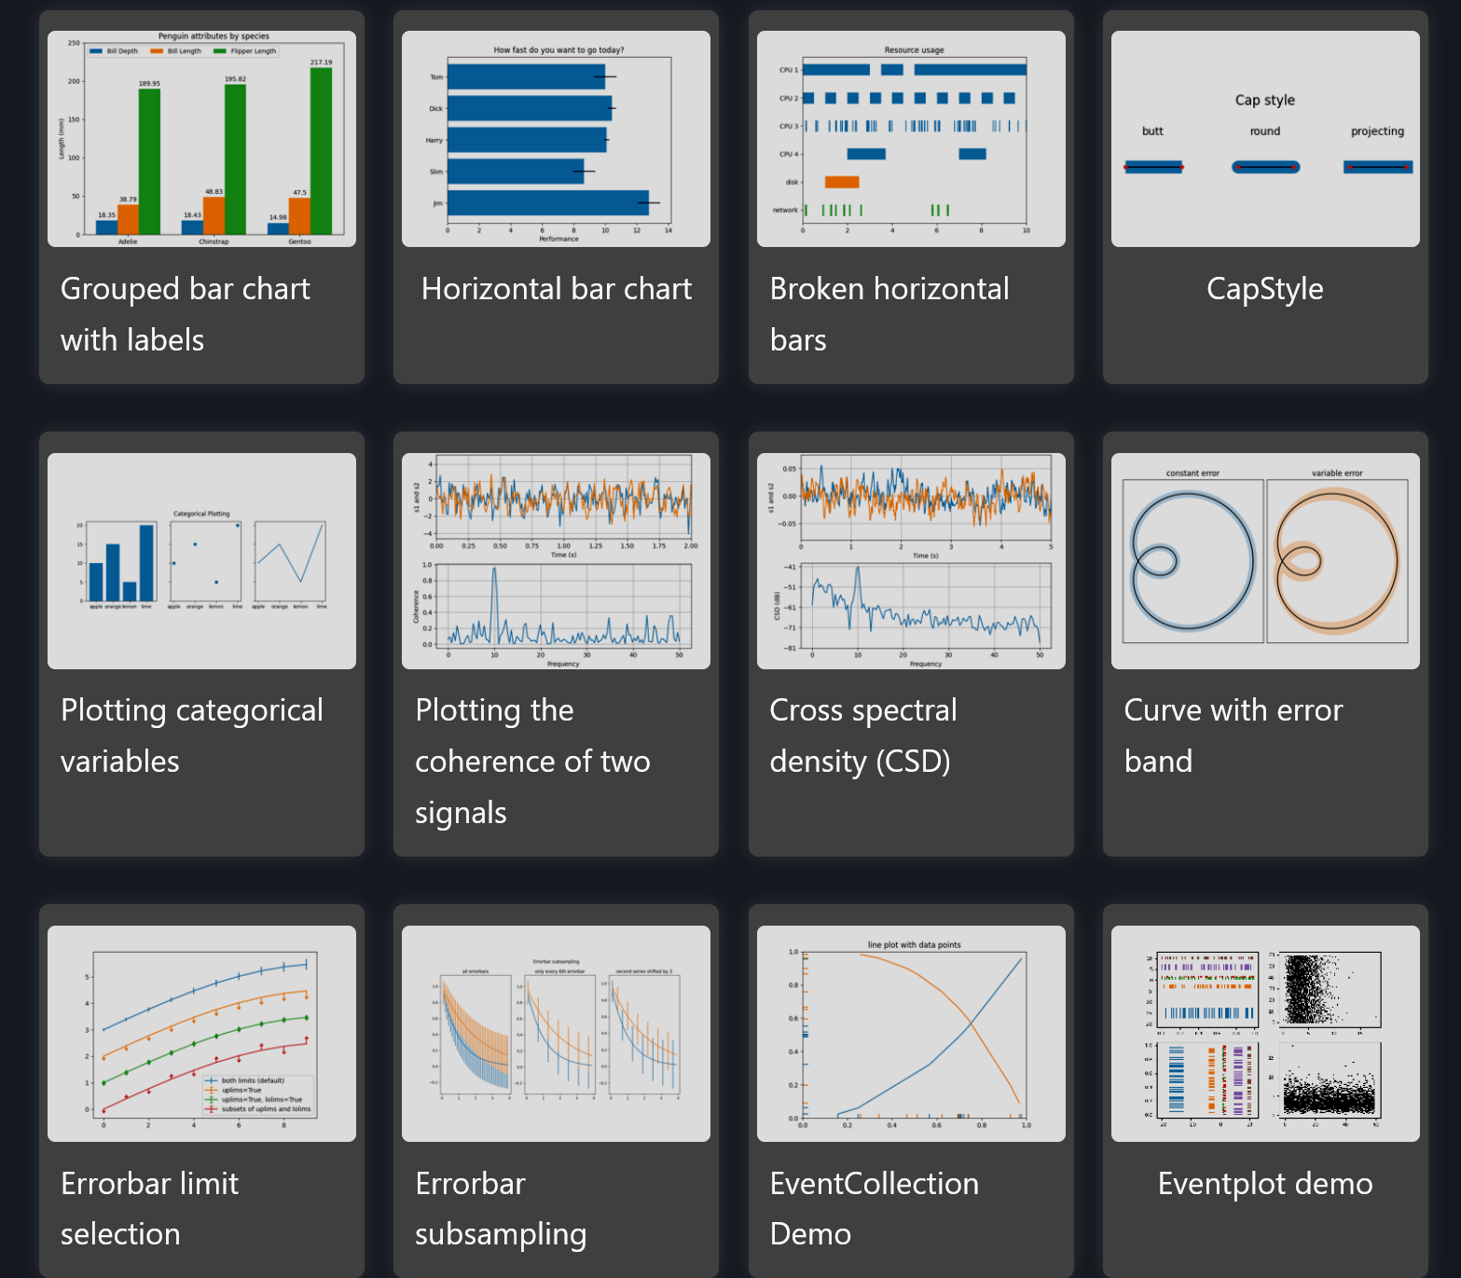
Visualizing your Data: Matplotlib
Most used plotting and visualization library
Examples

Slide 3
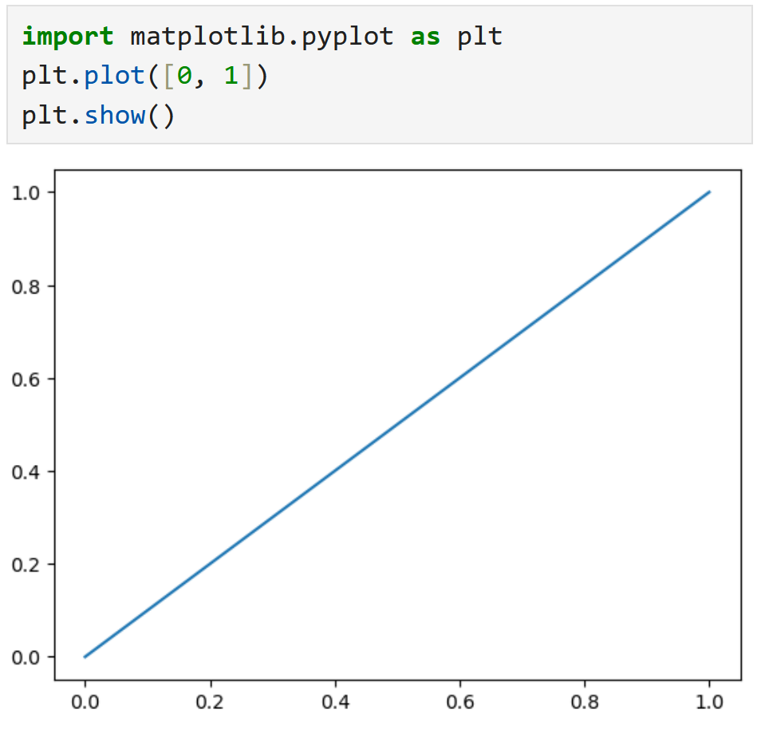
Live Coding: Getting Started
Anaconda Powershell Prompt: conda install matplotlib (See chunk 7 – imports for details)
Restart Kernel (if used before)
import matplotlib.pyplot as plt
Try:
submodule
submodule

Slide 4
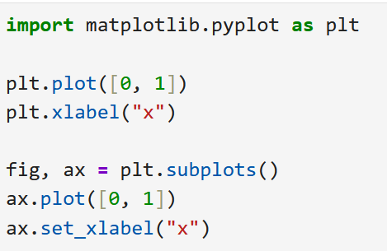
Two Types of Plotting
Two ways to use matplotlib: Quick & dirty or the clean way.
Quick & dirty:
Less code
Faster to learn
Limited
Clean way:
A little more boilerplate code
Slightly different coding “style”
Better for complex plotting (e. g. multiple plots next to each other)
Problem: Codes are similar, but slightly different → Be aware when googling stuff
Notes:
We will learn the “quick and dirty” way

Slide 5
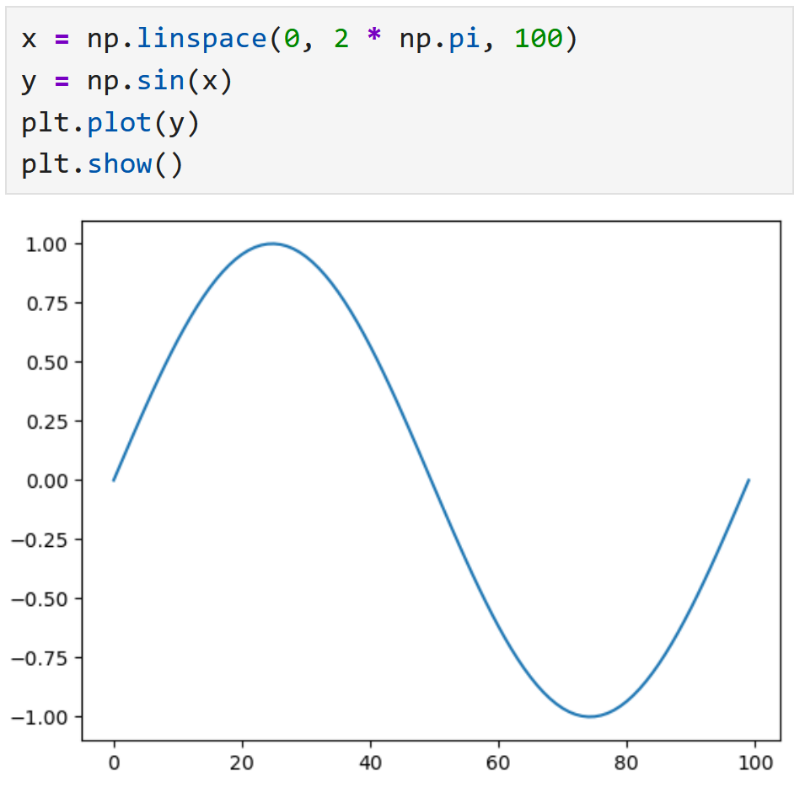
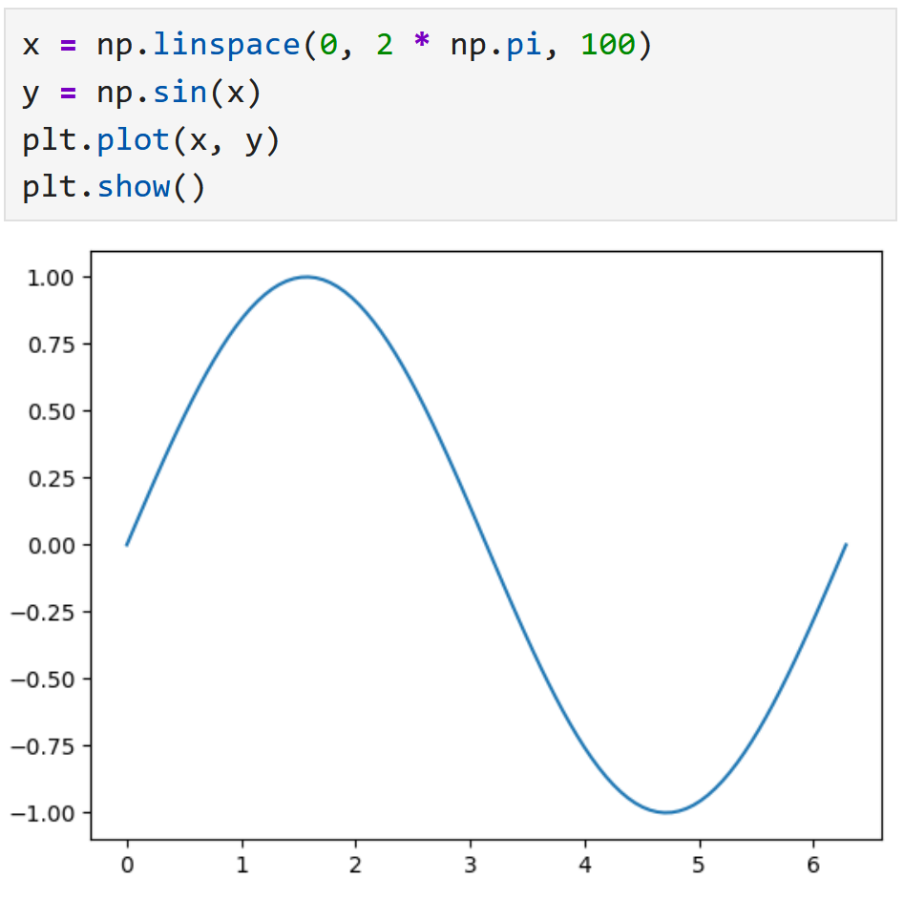
Live Coding: Basics of Plotting
plt.plot(): Can be used in two ways
Passing y-data → x-Axis is the index
Passing x- and y-data: → normal axis
plt.show(): Generates the plot
Mostly works without plt.show() but good practice to use it.

Slide 6
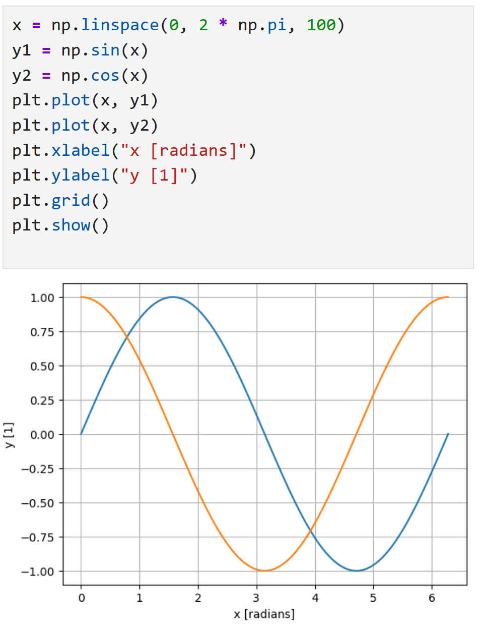
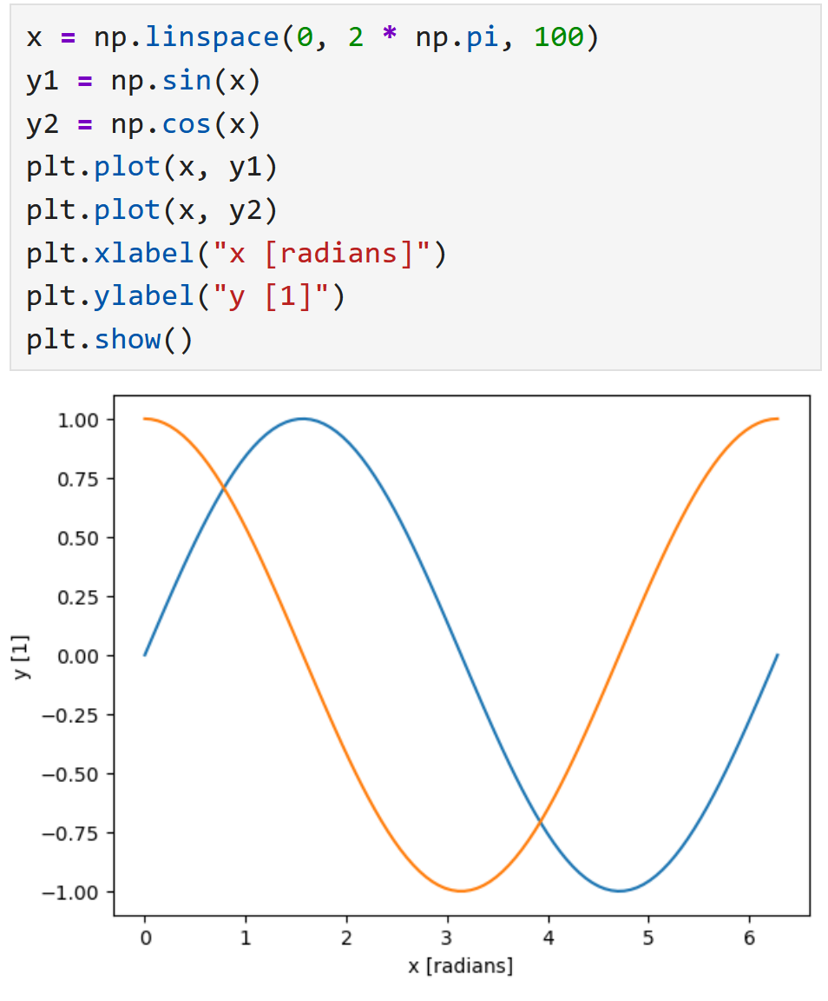
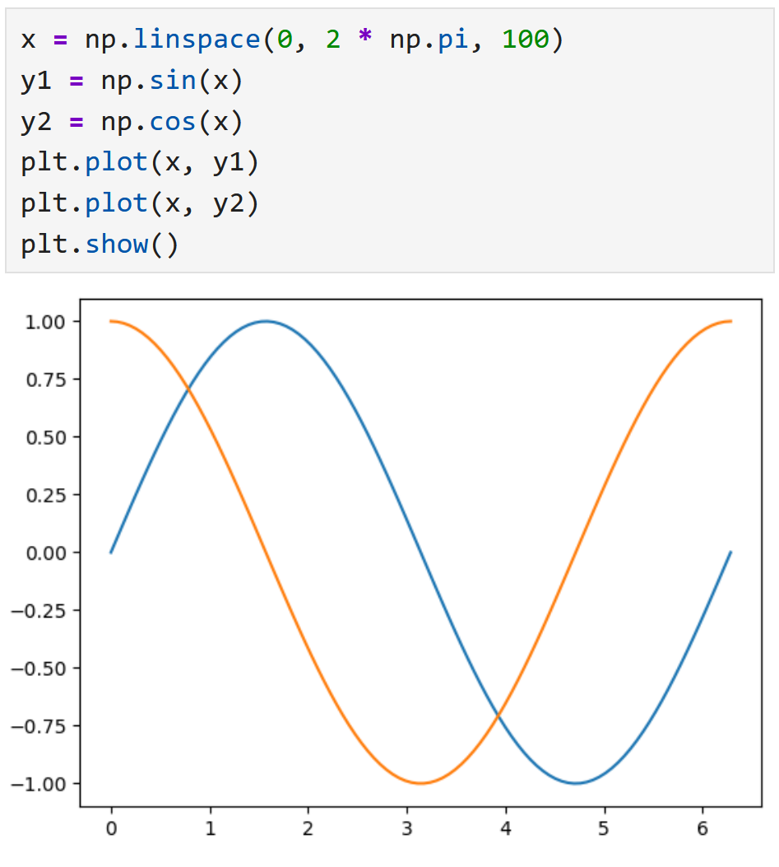
Live Coding: Adding to your Plot
More data: repeat plt.plot()
Add x- and y-label to your plot: plt.xlabel(“x”) and plt.ylabel(“y”)
Add a background grid: plt.grid()

Slide 7
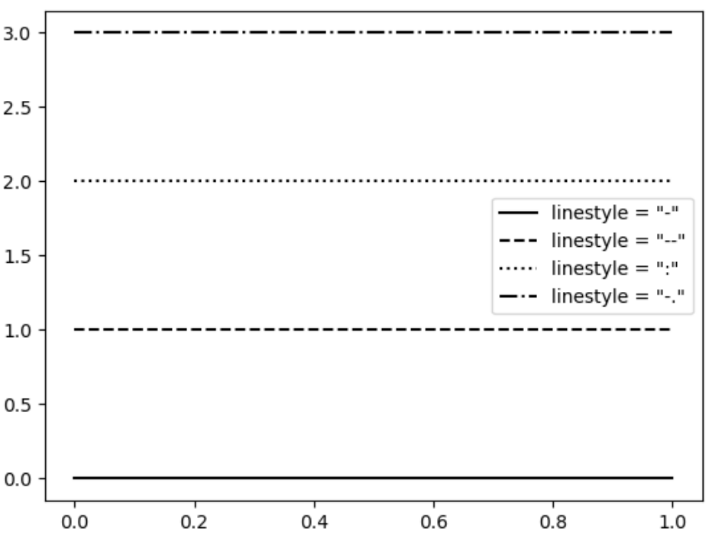
Options for plt.plot()
Besides x- and y-data, we can pass more optional parameters to the plot() function. To specify what we are passing, we can use “=“.
Example: plt.plot(x, y, c=“lightgrey”)
Optional arguments:
c → Color of the graph
linestyle → Style of the line
label → Strings get imaged → Need to call legend()

Slide 8
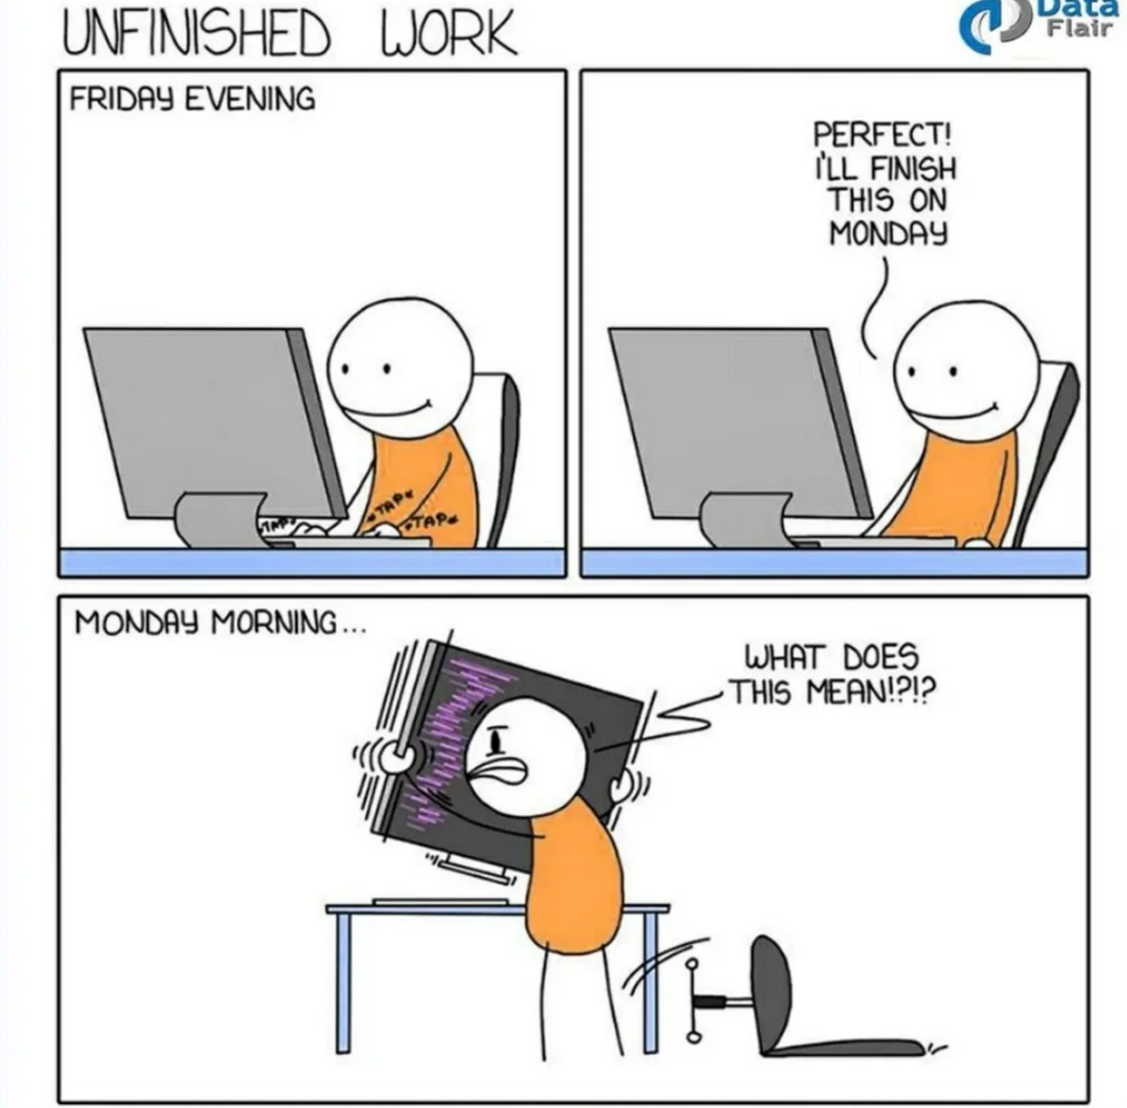
Good Luck with your Tasks ☺
[https://python.plainenglish.io/20-funny-programming-memes-that-will-make-your-day-5793a8e1608b]

